Slide 1
Average Size of A.clarkii Through the Years
Adriana Chumacero

Slide 2
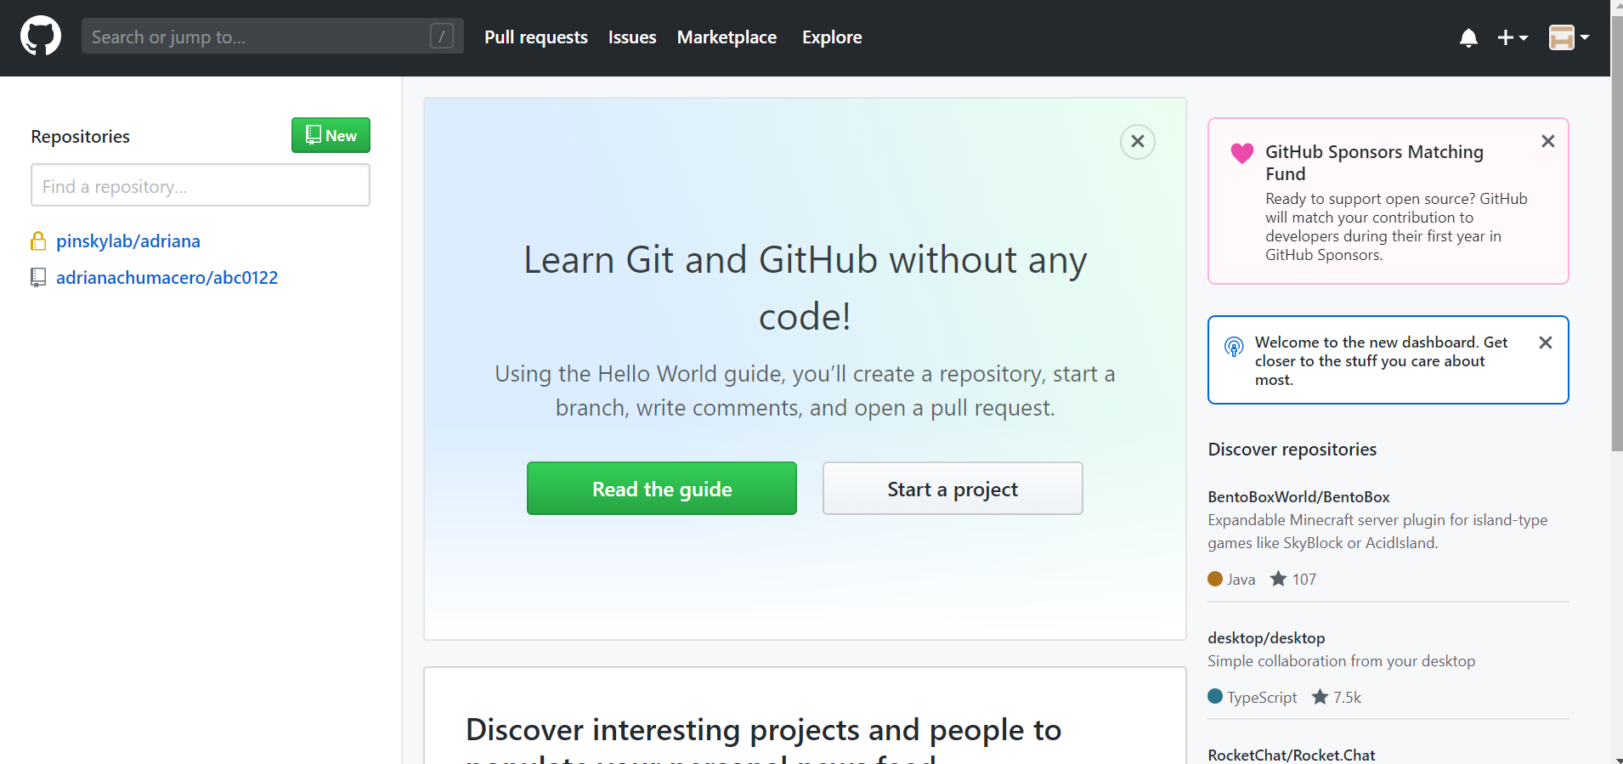
My GitHub Repository

Slide 3
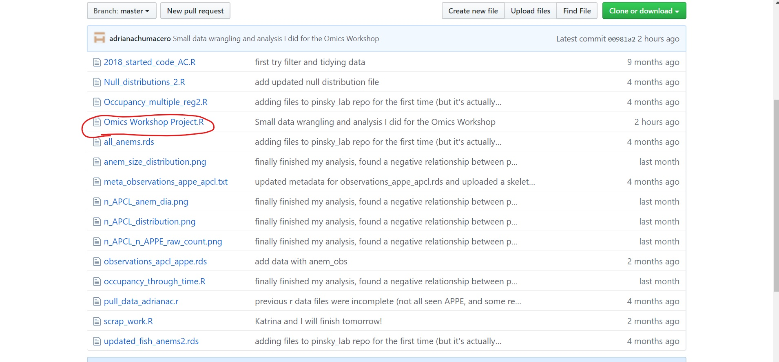
My GitHub Repository

Slide 4
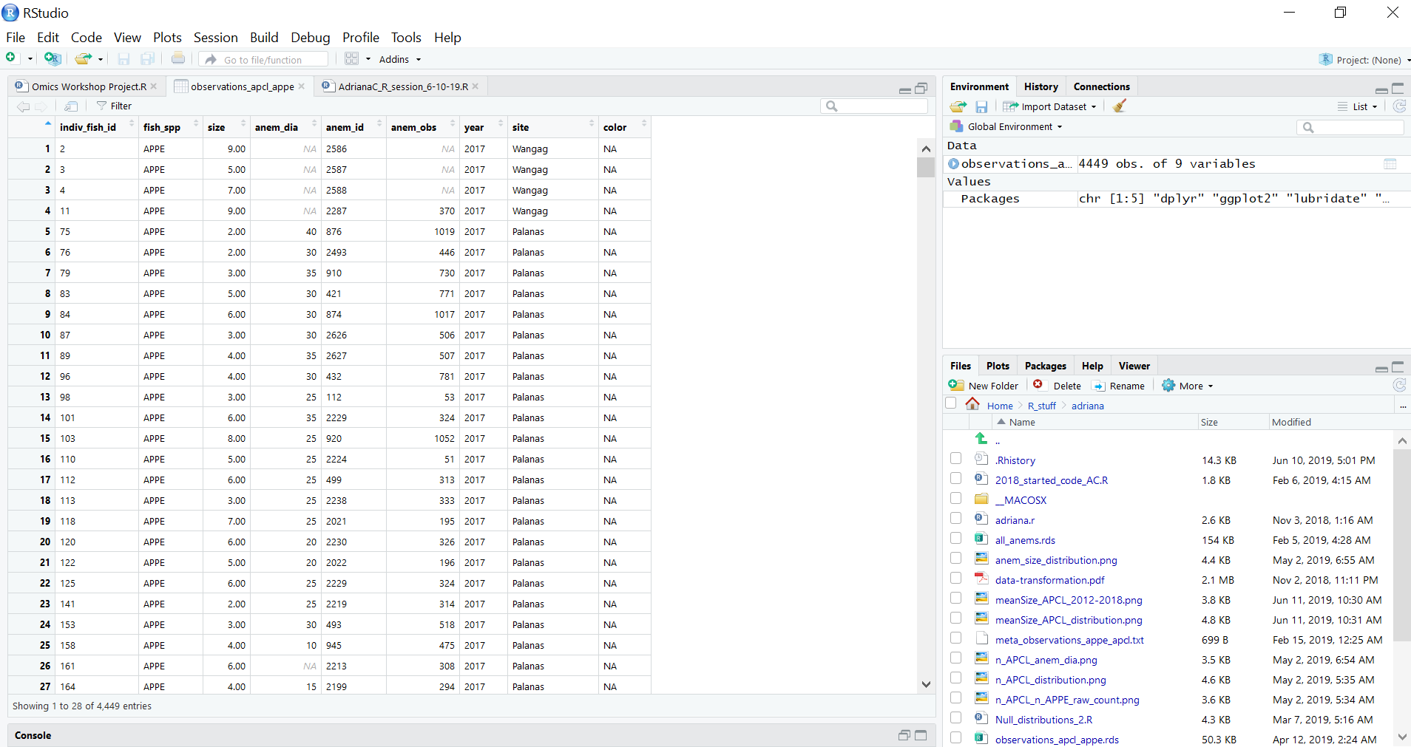
The data I used

Slide 5
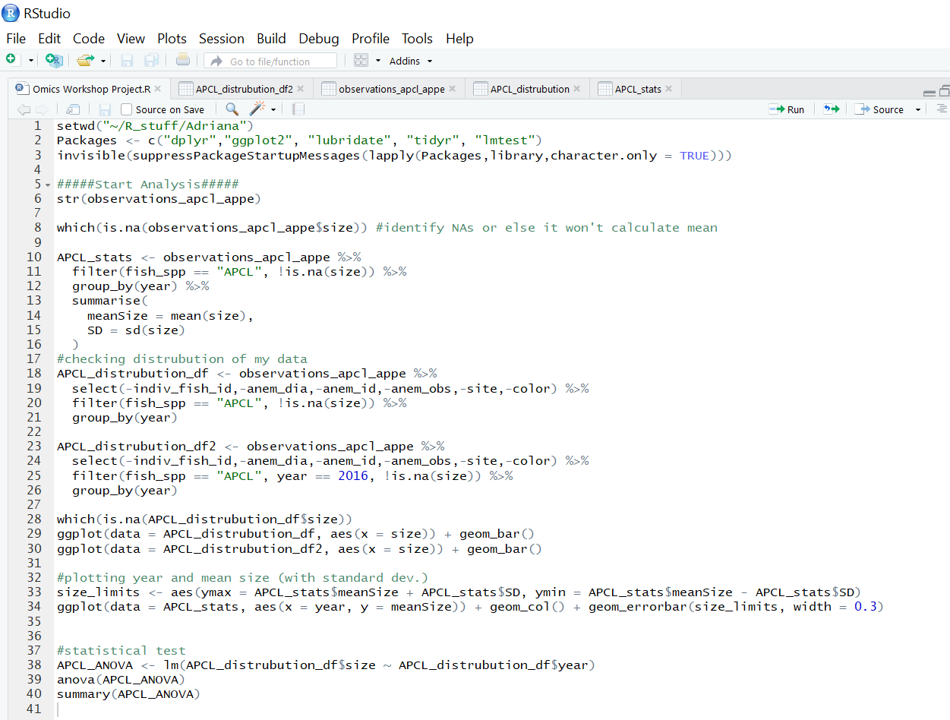
My R Script

Slide 6
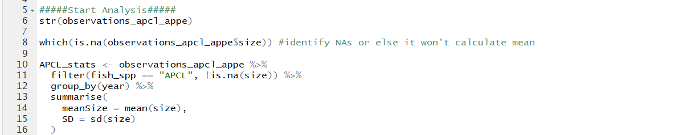
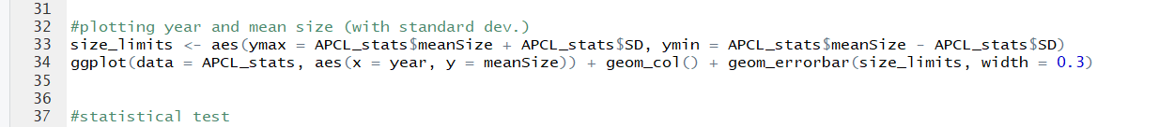
Code for main plot

Slide 7
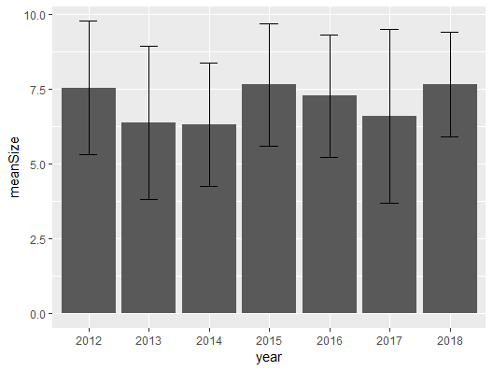
Average size of APCL from 2012 - 2018
Figure also includes standard deviation values

Slide 8
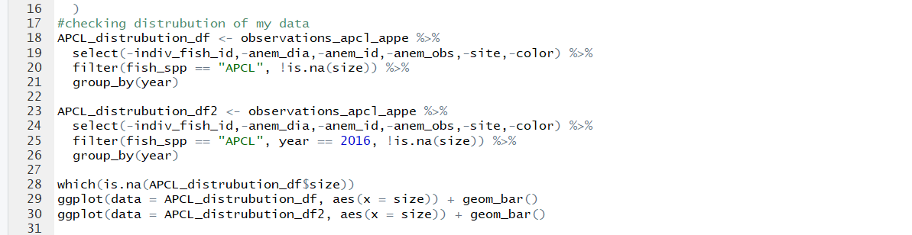
Code for distribution graph

Slide 9
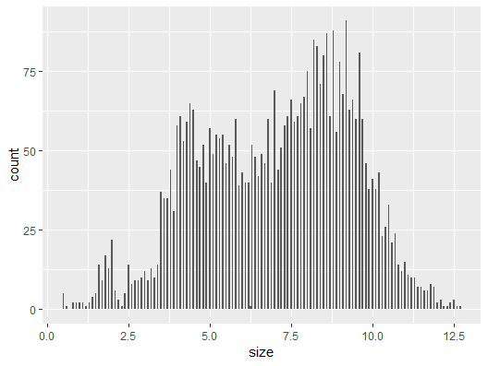
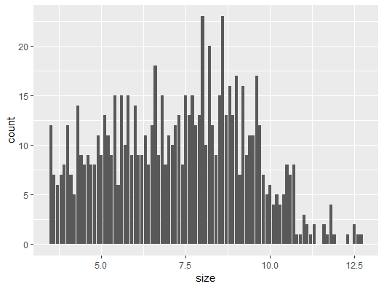
Distribution of size data
Throughout all years
In 2016

Slide 10
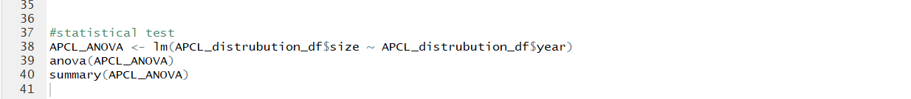
Code for my final analysis

Slide 11
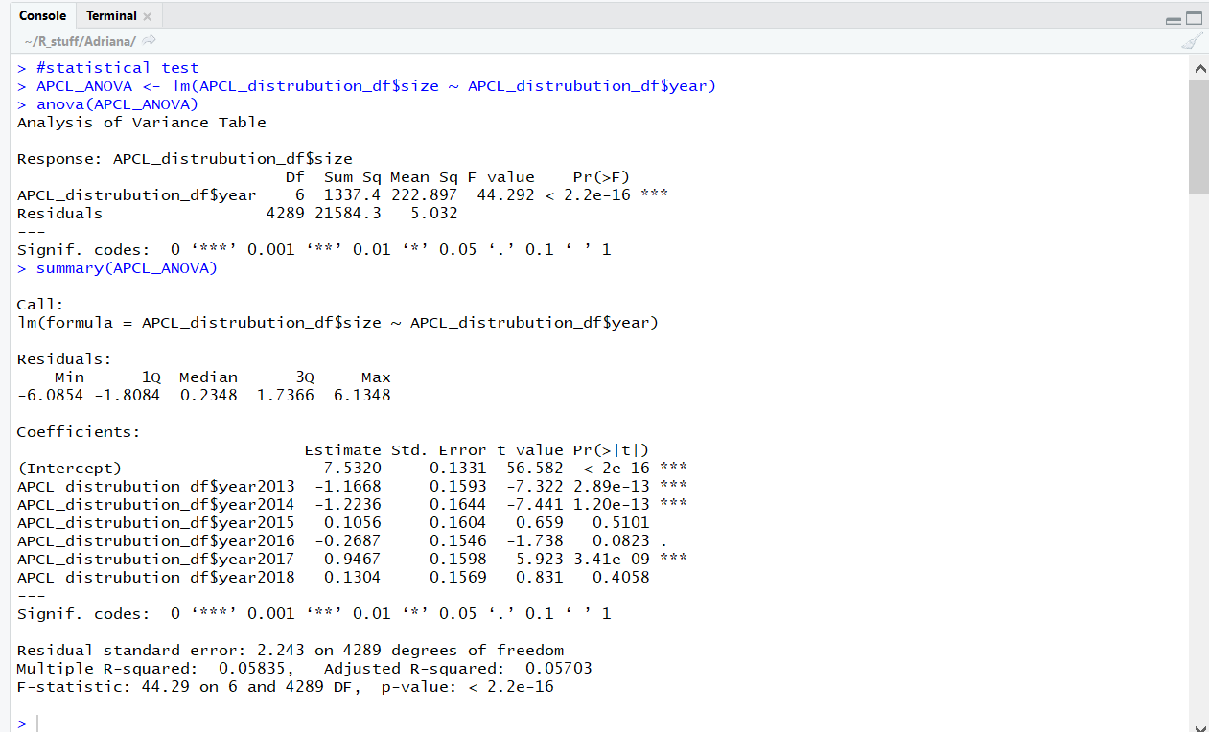
My Analysis

Slide 12
End
Thank You!

